Slide 1
Digital Transmission
Chapter 3.3

Slide 2
Analog to Digital Encoding

Slide 3
PAM

Slide 4
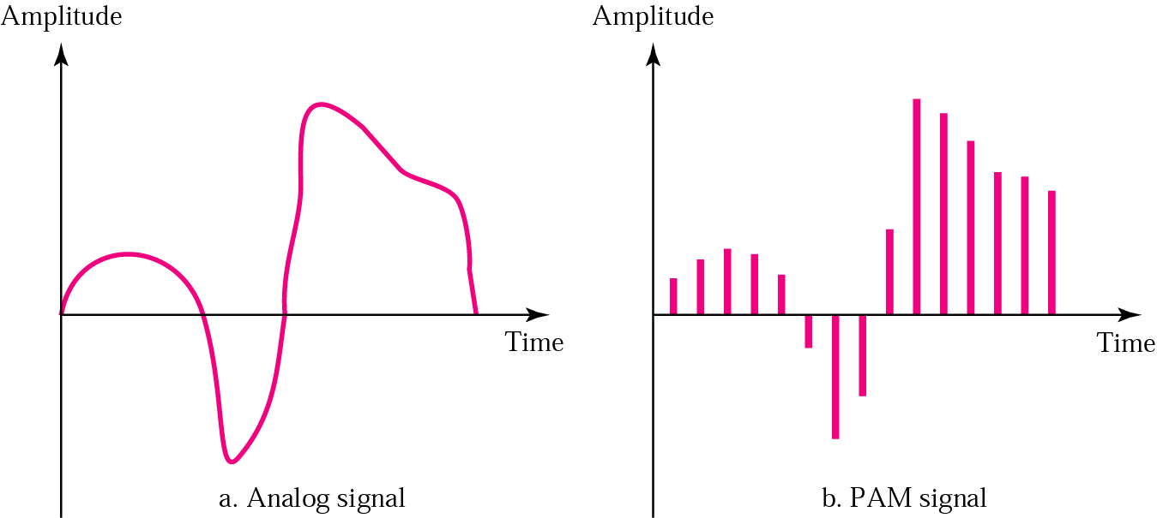
PAM: Pulse Amplitude Modulation

Slide 5
Pulse amplitude modulation has some applications, but it is not used by itself in data communication.
However, it is the first step in another very popular conversion method called pulse code modulation.

Slide 6
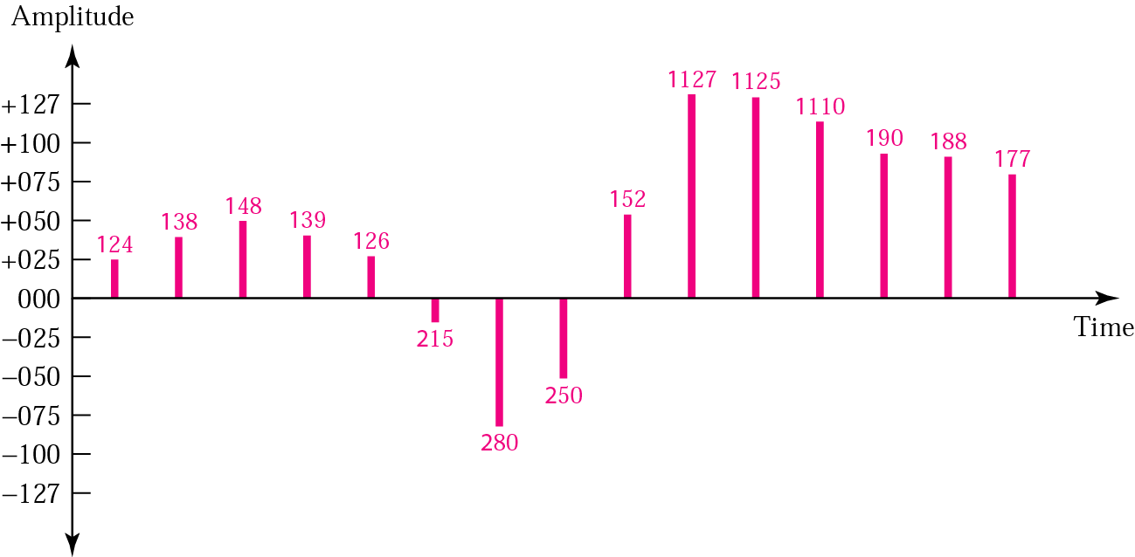
Quantized PAM signal

Slide 7
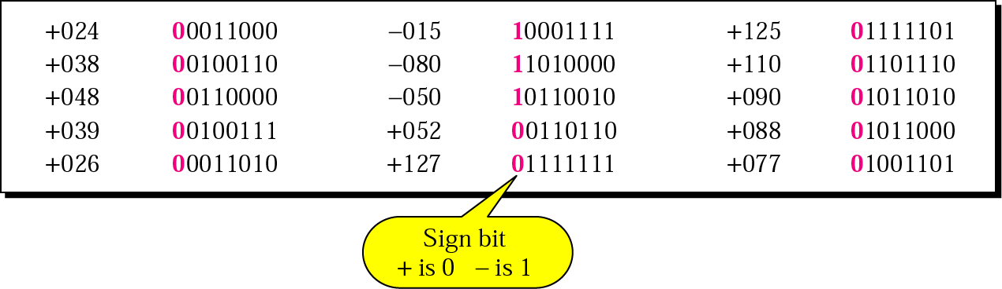
Quantizing by using sign and magnitude

Slide 8
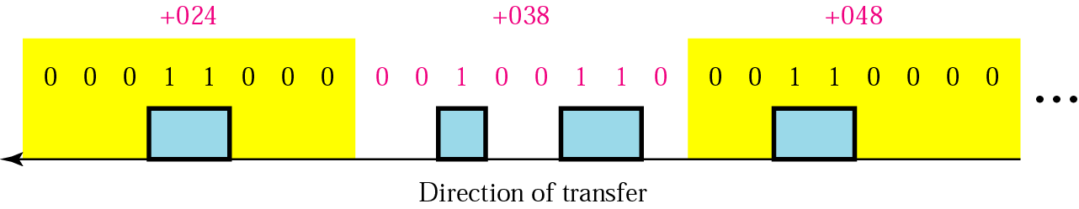
PCM

Slide 9
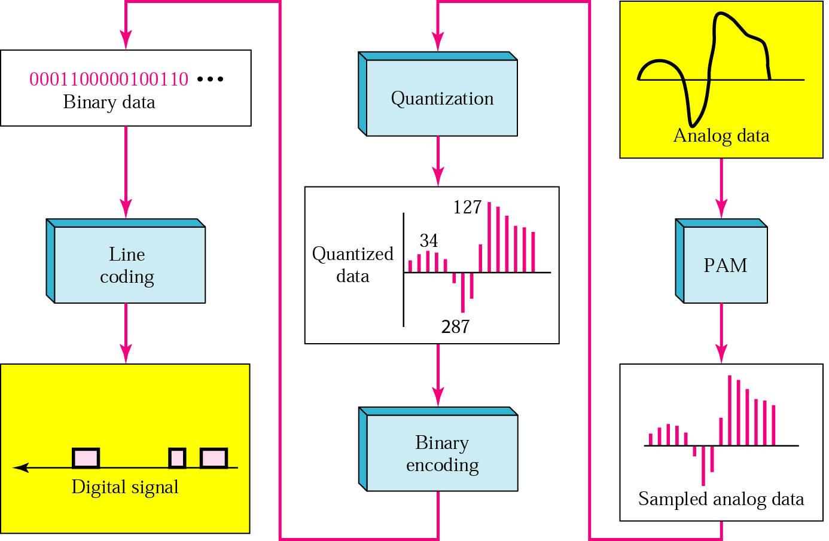
From analog signal to PCM digital code

Slide 10
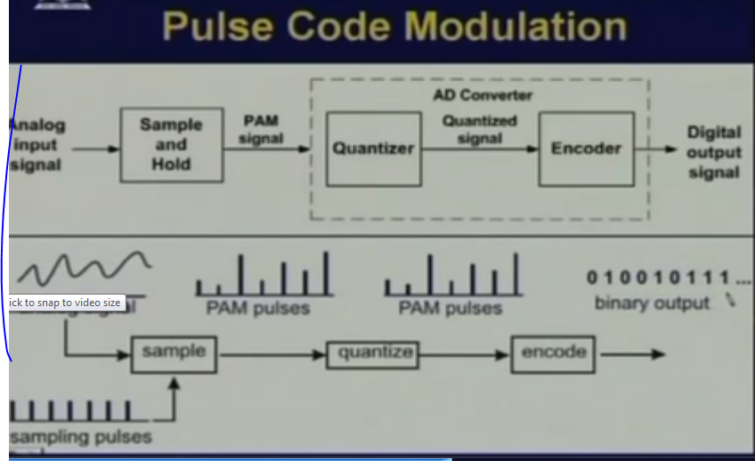

Slide 11
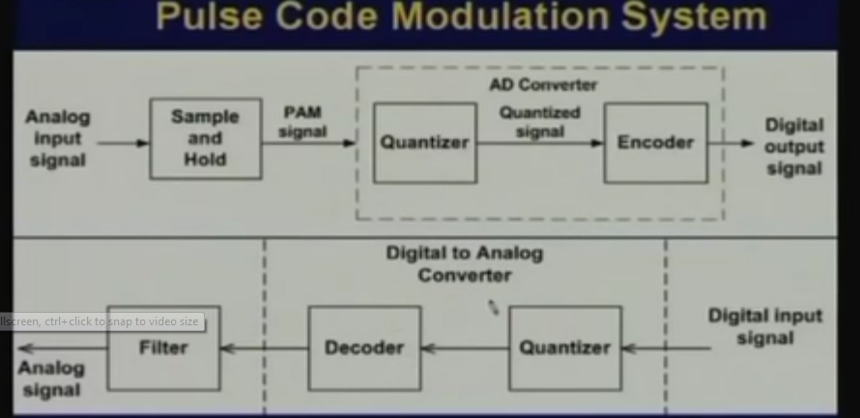

Slide 12
Note:
According to the Nyquist theorem, the sampling rate must be at least 2 times the highest frequency.

Slide 13
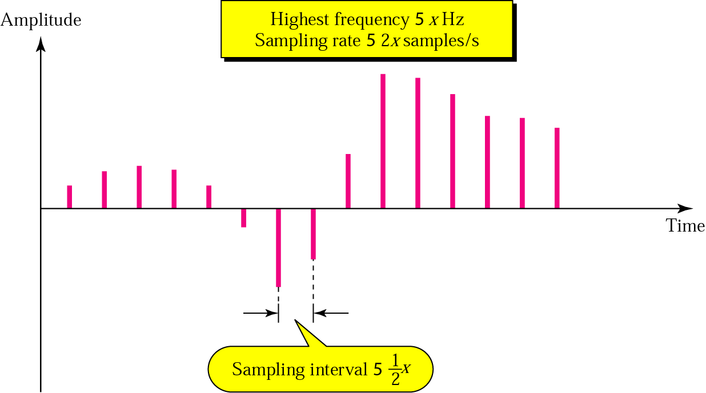
Nyquist theorem

Slide 14
Example 4
What sampling rate is needed for a signal with a bandwidth of 10,000 Hz (1000 to 11,000 Hz)?
Solution
The sampling rate must be twice the highest frequency in the signal:
Sampling rate = 2 x (11,000) = 22,000 samples/s

Slide 15
Example 5
A signal is sampled. Each sample requires at least 12 levels of precision (+0 to +5 and -0 to -5). How many bits should be sent for each sample?
Solution
We need 4 bits; 1 bit for the sign and 3 bits for the value. A 3-bit value can represent 2³ = 8 levels (000 to 111), which is more than what we need. A 2-bit value is not enough since 2² = 4. A 4-bit value is too much because 2⁴ = 16.

Slide 16
Example 6
We want to digitize the human voice. What is the bit rate, assuming 8 bits per sample?
Solution
The human voice normally contains frequencies from 0 to 4000 Hz.
Sampling rate = 4000 x 2 = 8000 samples/s
Bit rate = sampling rate x number of bits per sample = 8000 x 8 = 64,000 bps = 64 Kbps

